Slide 1
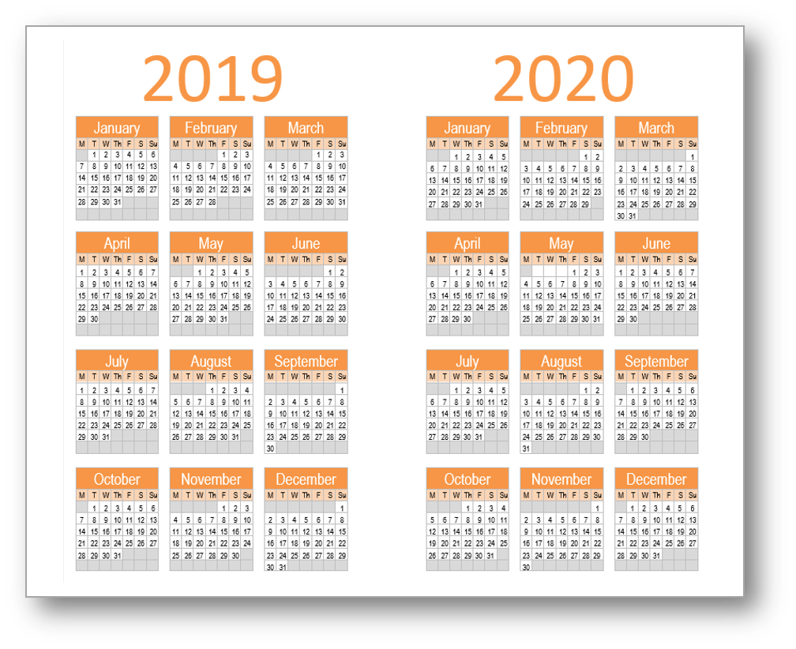
Board
Executive Director Performance Review
Audit Committee Report
Board Calendar/Committees
Board Performance Review
Strategic Plan Review & Update
AGM
Nominating Committee Report
Governance Committee Review
Operating Plan Review
This Photo by Unknown Author is licensed under CC BY-NC

Slide 2
FC
Audit Committee Report
AGM Prep
Operating Plan Review
This Photo by Unknown Author is licensed under CC BY-NC

Slide 3
GovComm
AGM Prep
Updated By-Laws
Policies & Procedures
This Photo by Unknown Author is licensed under CC BY-NC

Slide 4
Collections
This Photo by Unknown Author is licensed under CC BY-NC

Slide 5
FUN Raising
This Photo by Unknown Author is licensed under CC BY-NC

